Slide 1
Team IRun Final Presentation & Demo
20172864 서정현
20172848 정석우
20170364 한태균
Notes:
Hello, we are Team Irun, and I’m the presenter Seo Jeong Hyeon.
Let's start the presentation.

Slide 2

Project Overview
Notes:
Let’s start with project overview.

Slide 3
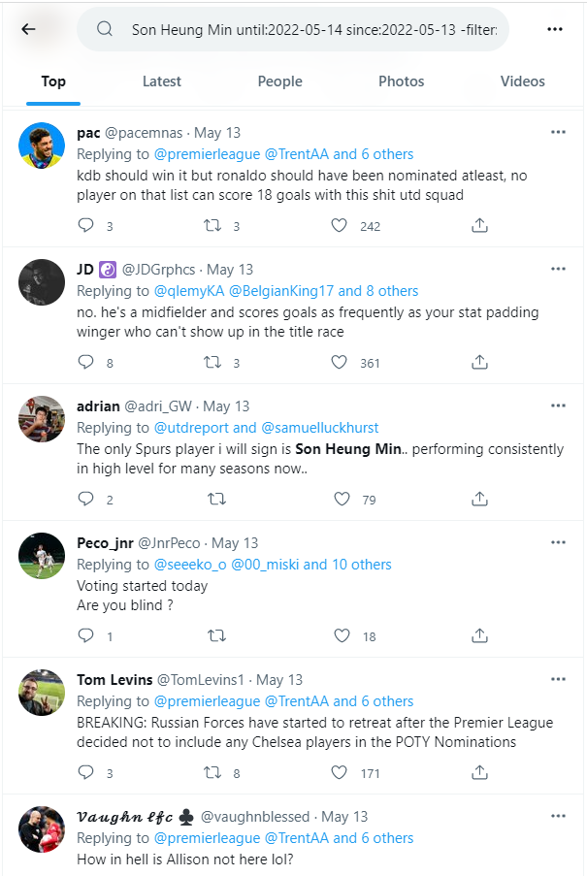
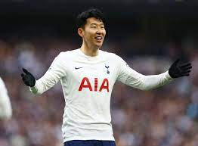
Overview
Query
User Rating: 8.5
Notes:
The goal of our project is to predict a player rating for a match through Twitter replies.

Slide 4


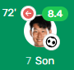
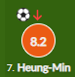
Overview
IRun
Son 8.5
new indicator !
Notes:
Player ratings are given by various sites such as whoscored, fotmob, etc.
We expect this ‘Irun rating’ could be a new football rating indicator given by non-professional users.

Slide 5




Corpus Idea
0.0~6.5
6.5-7.0
7.0~7.5
7.5~8.0
8.0-9.9
Notes:
We hypothesized that Twitter replies in a particular rating interval would have a certain tendency.
So, we received match data through an api called api-football,
and collected twitter replies through an api called tweepy,
and classified them according to a predetermined rating section.
So these classified replies become corpus.

Slide 6




Data Collection
Documents | Last Week Tweets | This Week Tweets
0~6.5 | 2626 | 3299
6.5~7.0 | 3633 | 3809
7.0~7.5 | 2504 | 2671
7.5~8.0 | 2447 | 2556
8.0~ | 1433 | 1503
Total | 12643 | 13838
Notes:
Since all the popular fooball leagues are over, we have additionally collected matches of American football leagues called MLS.

Slide 7
Fix Stopwords
Add
Player name
Team name
Number
Meaningless words
player
team
time
play
left
right
etc
Remove
Meaningful words
appropriate
important/importance
interested/interesting/interest
necessary/necessarily
novel
problem
sensible
significant/significantly
successfully
etc
Notes:
We are using large stopwords to tokenize only meaningful words for player evaluation.
So we added words to stopwords that have no meaning in player evaluation such as player names, team names, numbers, or words like these.
Also, We found that the existing stopwords included important words such as "important", "necessary", and "sensible“, so we removed them.

Slide 8
Architecture
irun.py
api_football
_requester
api_football
_module.py
twitter_crawler
doc_maker.py
twitter_crawler.py
vsm
vsm.py
query_maker.py
twitter_secret.py
corpus
0.0-6.5.txt
6.5-7.0.txt
7.0-7.5.txt
7.5-8.0.txt
8.0-9.9.txt
api_football _secret.py
Notes:
We modularized our code like this.

Slide 9
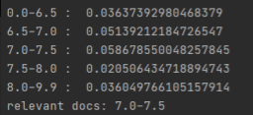
Rating Derivation Algorithm
The problem with the last result
We don't want an interval, we want a specific value !
Notes:
In general, vector space model is used for ranking, but in our project, the purpose is to determine a specific rating value using this similarity result.
So, we derive the rating value through the following algorithm.

Slide 10
Rating Derivation Algorithm
Apply min-max normalization to the result.
Apply exp(x * 𝛼) - 1 to the result.
Normalize the result by dividing by sum of result.
Calculate the rating as the dot product of result and docs weight.
Notes:
First, the result is normalized to between 0 and 1 through min-max normalization.
Next, we use an exponential function to increase the difference between large and small values. If this alpha value is larger, small similarity values are gradually ignored.
Next, the result value is divided by the sum so that the sum of the result becomes 1.
Finally, the rating is determined through the dot product of pre-determined document weights and the result. Let's see an example.

Slide 11

Web
What we have done :: get tweets about a player, made a criteria to create a rating for them -> Made simple web api to convert user-input query into ‘irun-rating’
An example of single sentence query input : “His play is amazing; his every shooting becomes a nightmare to the goalkeepers”, or “His pass is the worst. Even my 5-year-old child can pass well than him”
Notes:
To conclude, we have done with making criteria for rating calculation.
So we made a simple web api to convert user input query to our irun rating using python’s flask framework. An example of single sentence query input is like below.

Slide 12
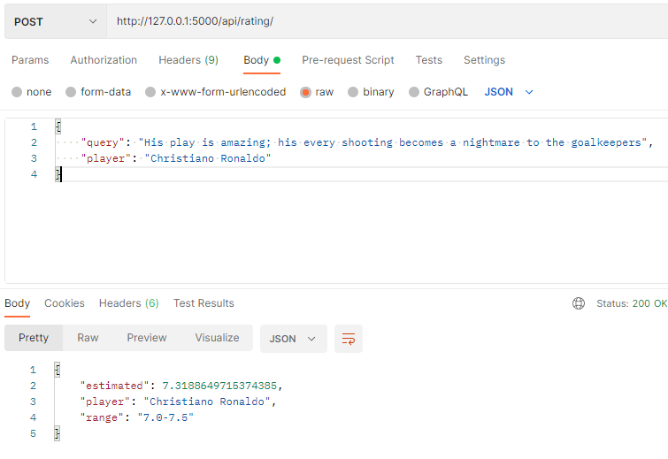
Web
Notes:
First example query is ‘his play is amazing, his every shooting become a nightmare to the goalkeeper’.
This query got 7.31 irun rating.

Slide 13
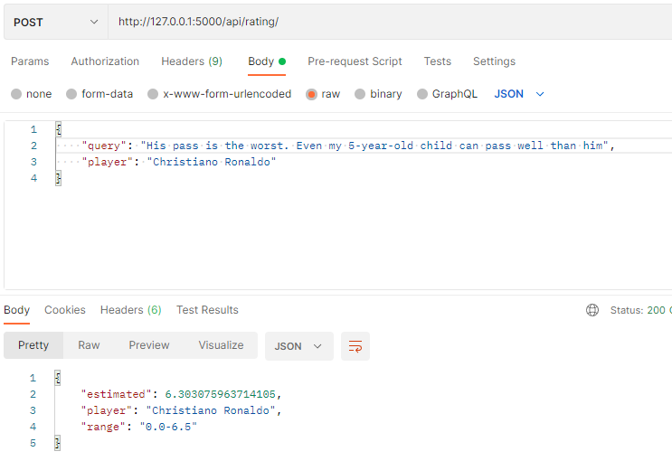
Web
Notes:
Here is another query example : ‘his pass is the worst, even my 5-years-old child can pass better than him’ and this query got 6.30 irun rating.

Slide 14

Demo
Notes:
Now, Let’s see a Execution.

Slide 15
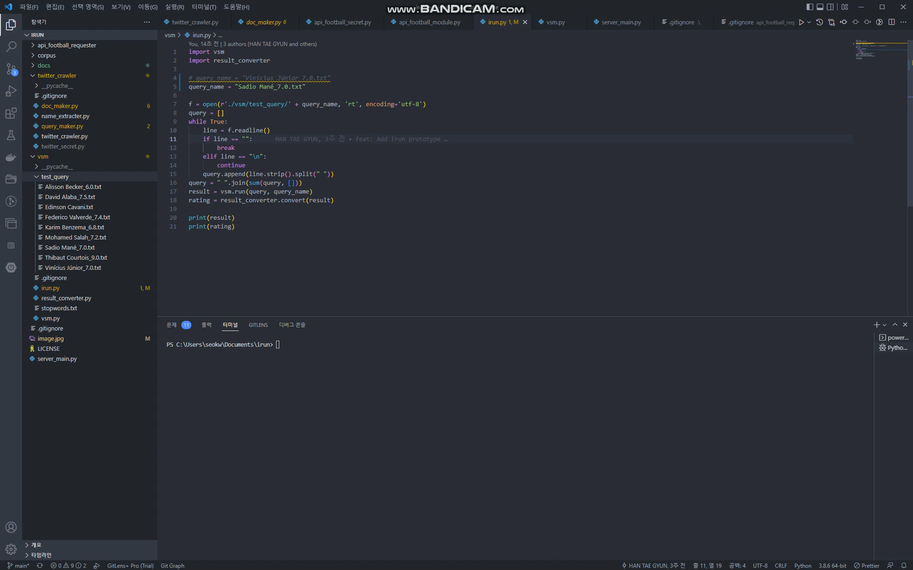
Notes:
This is a video of getting Irun Rating with a previously created query file.

Slide 16
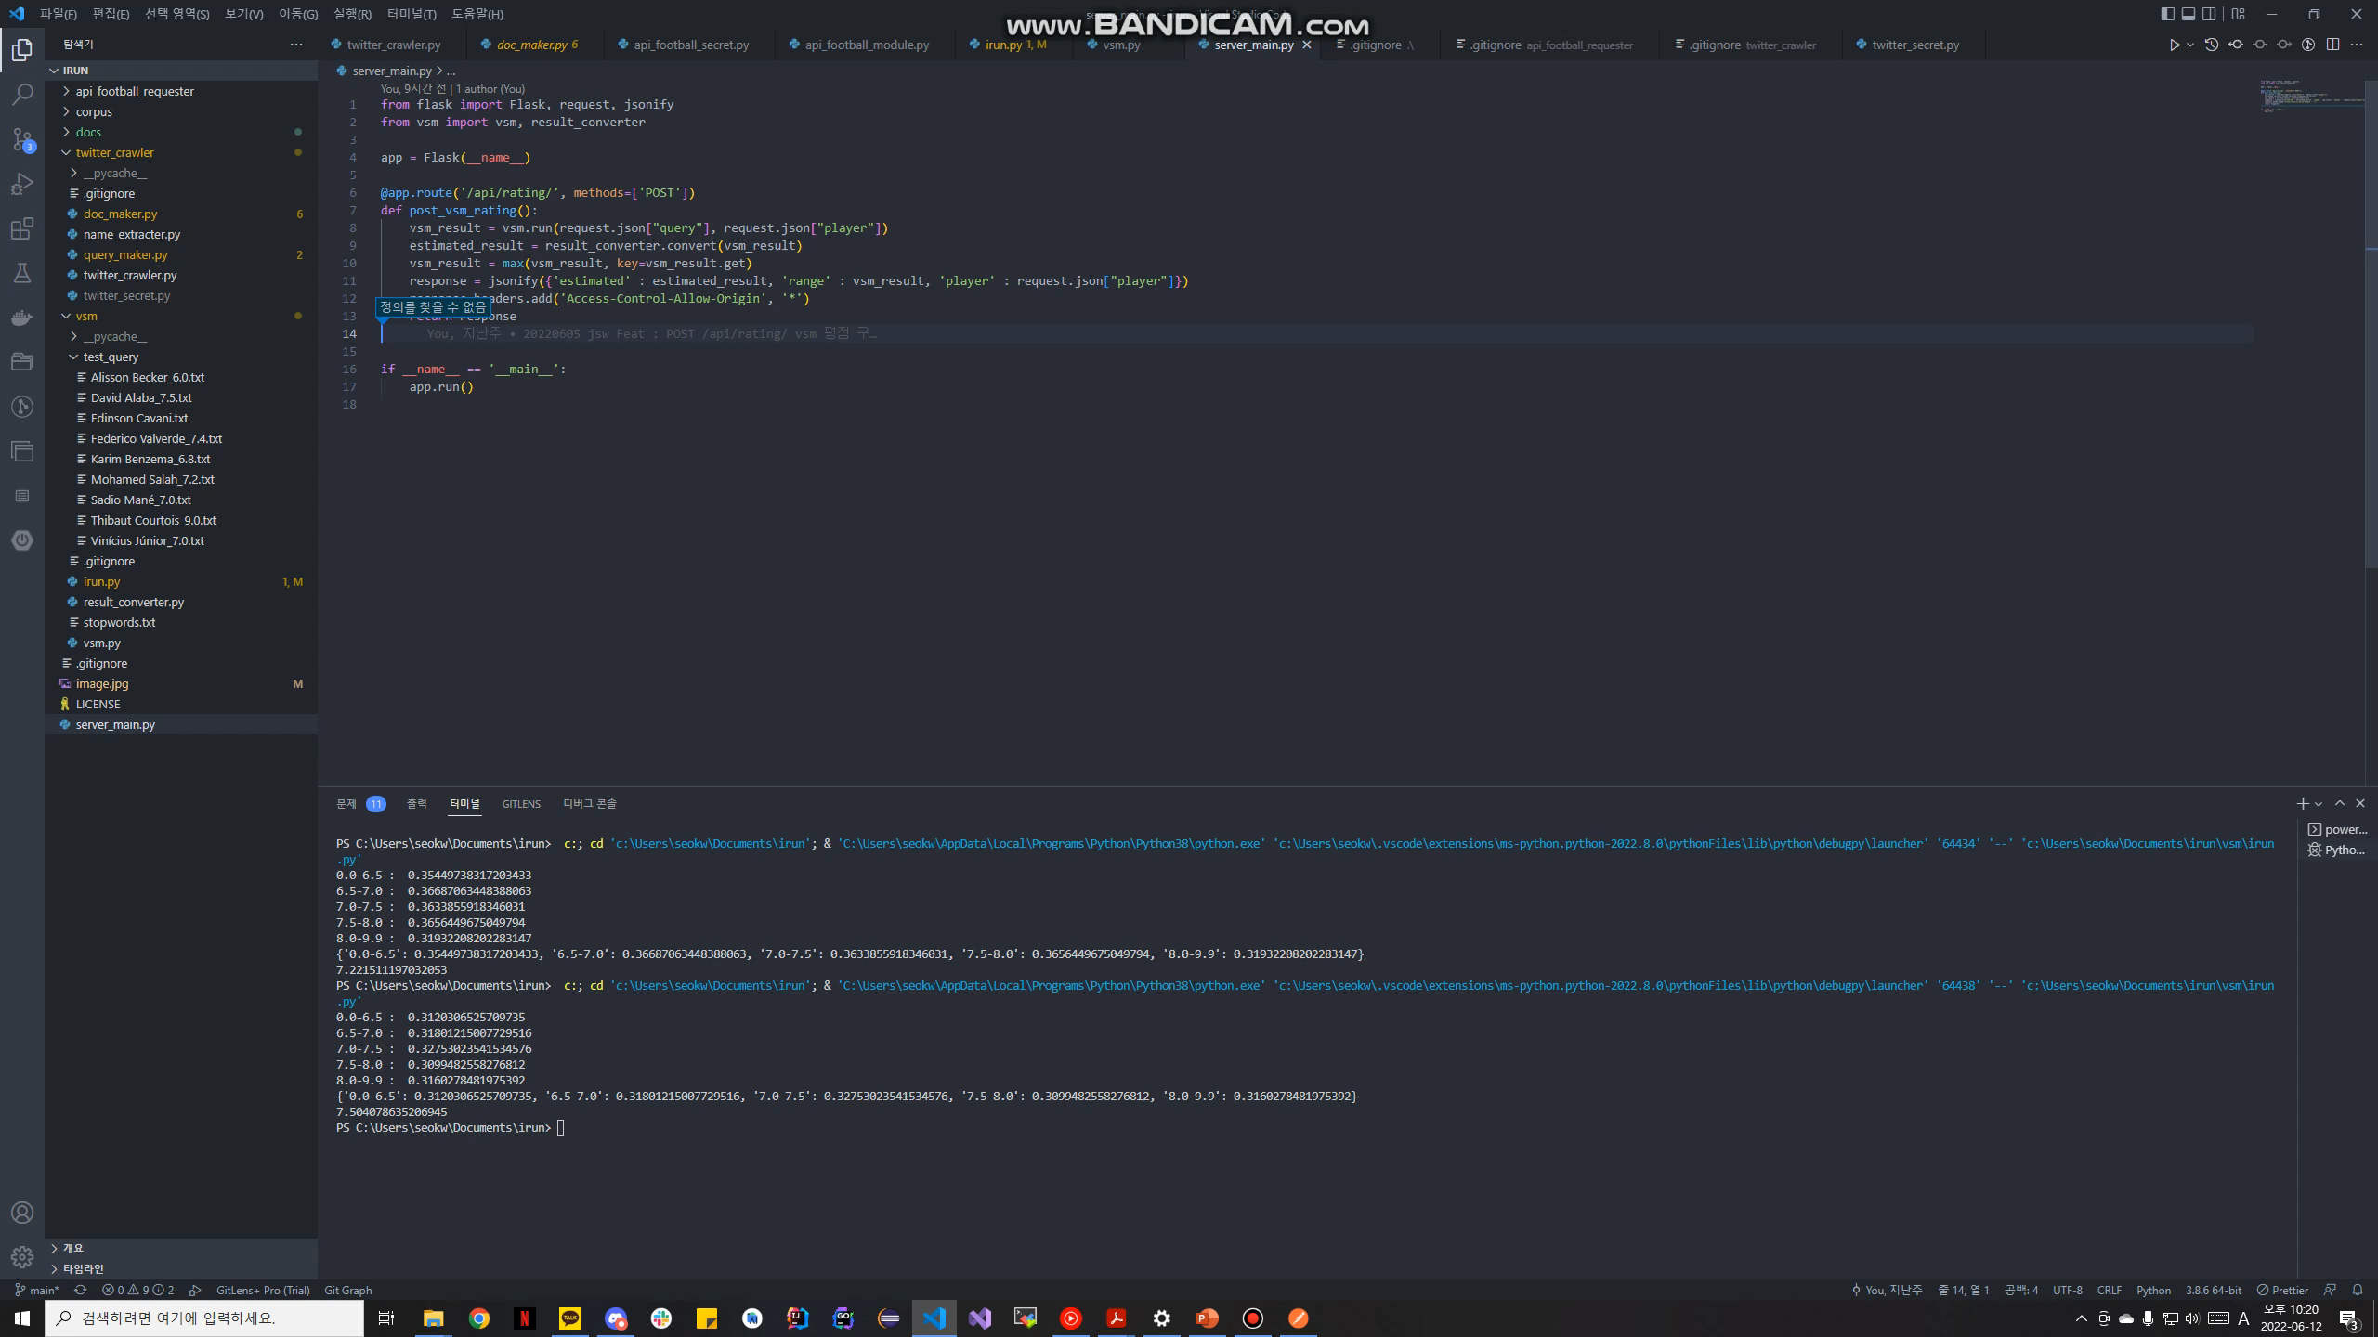
Notes:
This is a simple web api test video.

Slide 17
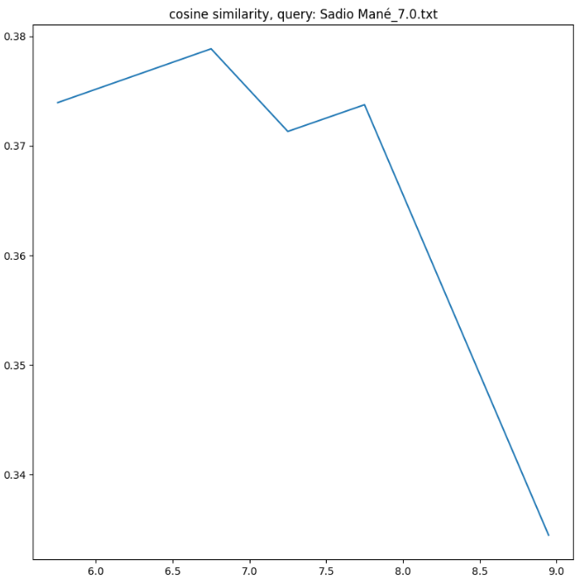
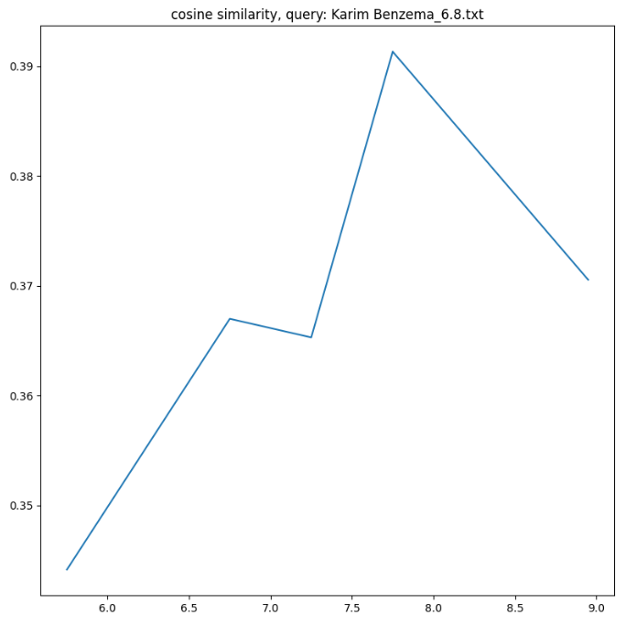
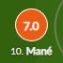
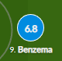
Evaluation
Match : Liverpool(0) vs Real Madrid(1)
Champions League Final Stage
Sadio Mane
(FW)
Irun model:
[6.5 ~ 7.0]
Whoscored.com:
[7.0]
Karim Benzema
(FW)
Irun model:
[7.5 ~ 8.0]
Whoscored.com:
[6.8]
Notes:
Evaluation. As we decided to compare our irun rating to other rating products. This is the graph of our irun rating model.

Slide 18
Player Name | Whoscored Rating | Futmob Rating | IRun Rating | Whoscored MAP | Futmob MAP
Karim Benzema | 6.8 | 7.3 | 8.1 | 0.0666 | 0.04
Sadio Mane | 7.0 | 6.6 | 7.0 | 0.0666 | 0.04
David Alaba | 7.5 | 7.5 | 6.4 | 0.0666 | 0.0666
Federico Valverde | 7.4 | 8.1 | 6.8 | 0.04 | 0.2
Vinicius Junior | 7.0 | 7.4 | 7.6 | 0.04 | 0.2
Notes:
We calculated each query into irun rating module, got a irun rating range. Then we compared with actual rating from whoscored and futmob. Highest value of MAP is 0.2, because we decided to set ideal case, which irun model returns with exact rating document as 1st document among 5 documents. So at every case, the number of relevant document is 1, that makes MAP not high. Two query cases were idel for futmob rating, but not at whoscored on average. Red indicated value was the worst, which means irun module ranked as 5^{th.}

Slide 19
Thank you
Notes:
The presentation is over. Thank you.

